Slide 1

Title VI Learning Series
UTSA
Introduction to Judaism and Antisemitism
Lisa Epstein, PhD
Director, Jewish Community Relations Council
210-302-6962
epsteinL@jfsatx.org

Slide 2
Agenda
Part 1: Introduction to Judaism
Part 2: Antisemitism Explained
Part 3: Title VI Civil Rights Act Applied

Slide 3

Introductions
Name
Role/Department

Slide 4
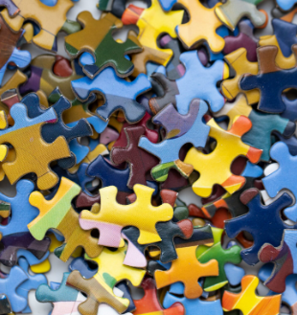
Identity

Slide 5
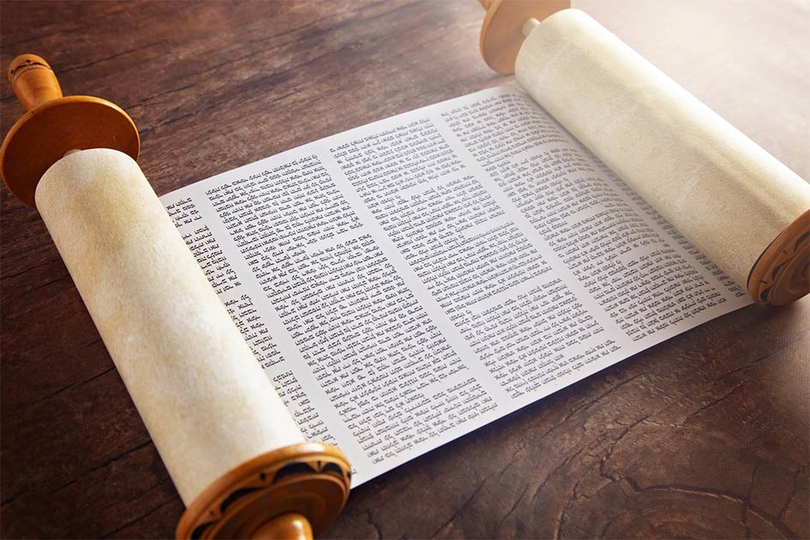
Beliefs
Judaism originated with Abraham around 2000 BCE
First monotheistic religion
Founded in the land of Israel
A people, a religion, a culture
Is Based on the Torah, or Hebrew Scripture
We read from the Torah in synagogue a different chapter each week
We pray in Hebrew and English (or the language of the land)
Tikkun olam, tzedakah

Slide 6
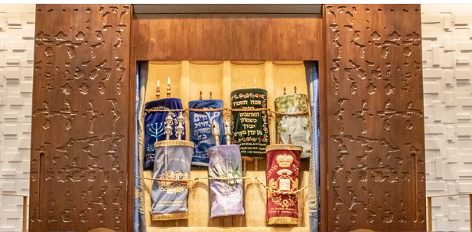
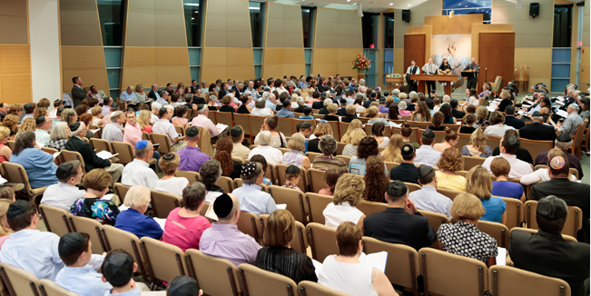
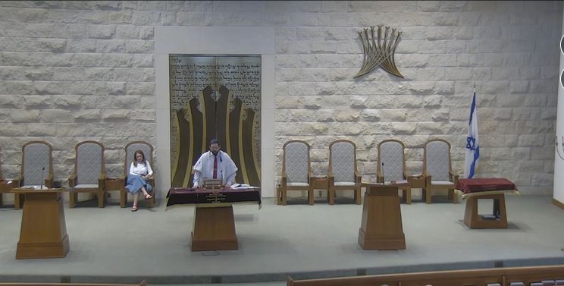
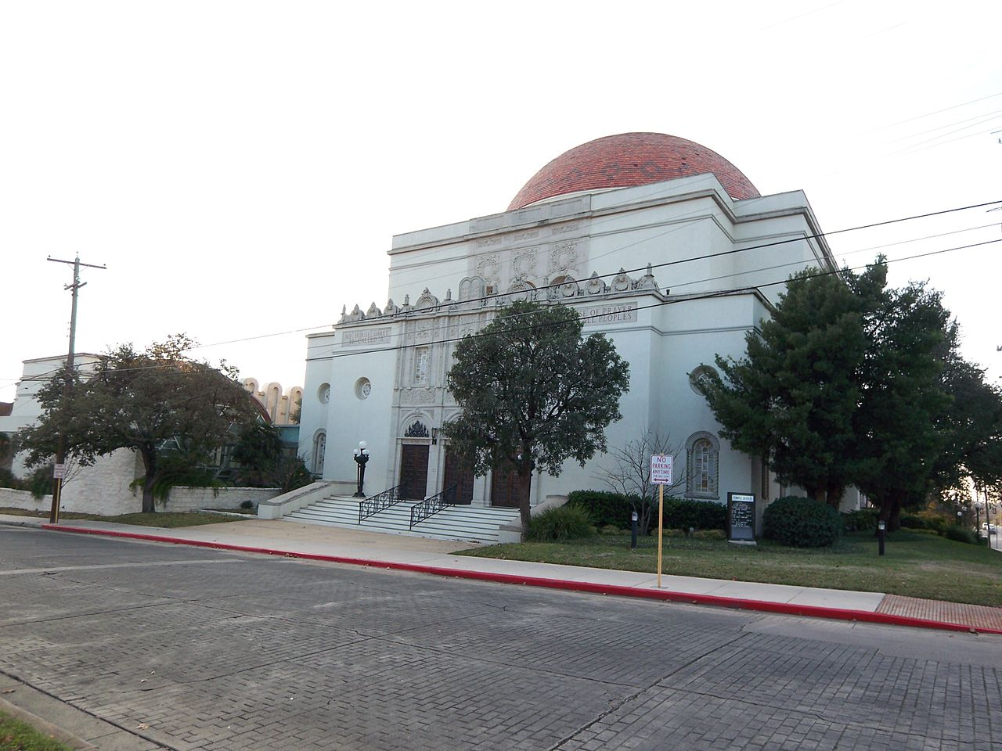
The Synagogue

Slide 7
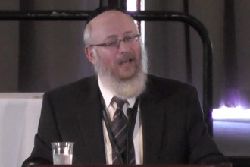
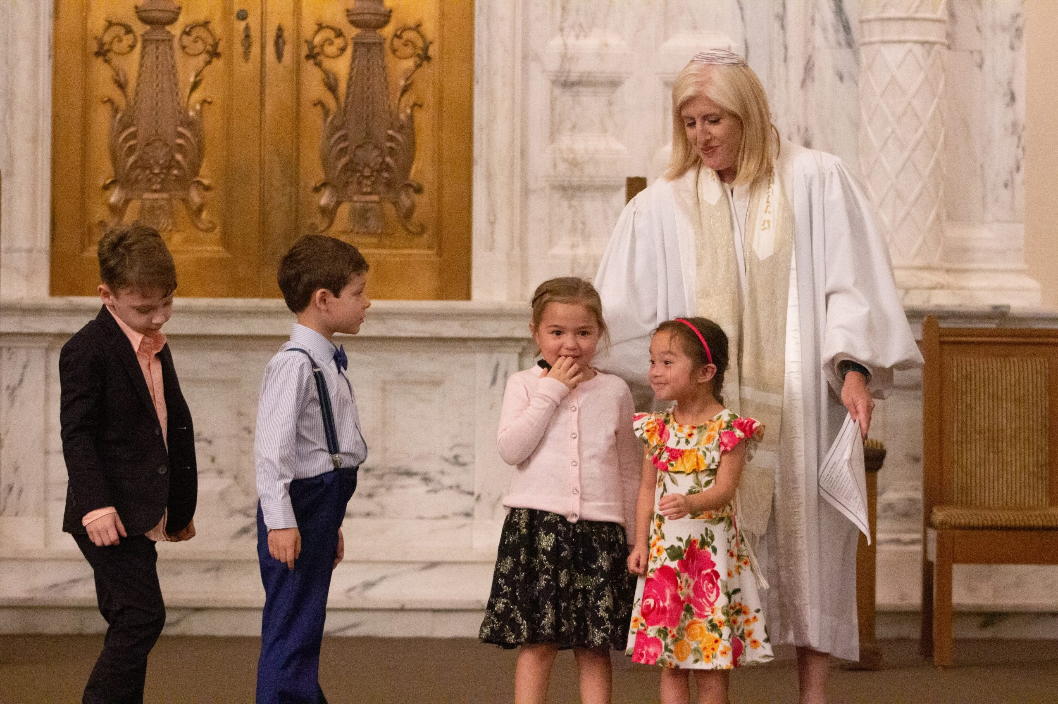
Rabbis
Rabbis Are Leaders
Rabbi is Hebrew for “master” or “teacher,” and a rabbi is a learned Jew who guides other Jews in their Torah study, mitzvah observance, and service of G‑d.
Can be any gender. A rabbi can look like me—or can look like what you may envision as a traditional Rabbi, a man with a long beard
Title earned from studying

Slide 8
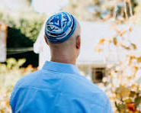
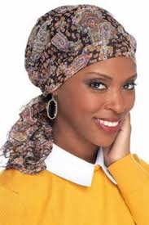
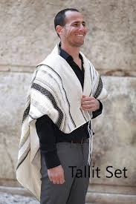
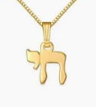
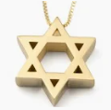
Observance
Range of Jewish practice
  Reform Judaism Orthodox-most traditional, other traditional forms known as “Chabad” and “Hasadic”
  Conservative- “in-between”
Dress
  Some Jews dress modestly, women wear long skirts, men in long beards with kippah or hat always, married women may have scarves, wigs or hats covering their hair
  Others, wear modern dress, don’t wear kippahs or any distinguishing clothing
  Symbols: Star of David, Chai
  Prayer shawls while praying (Tallit or tallis)
Sabbath-also a range of observance
  Begins on Friday night at Sundown
  No electricity, cars, phones, until Saturday night at sundown for Orthodox
  Synagogue serves on Friday night and Saturday morning

Slide 9


Kosher/kashrut
  Comes from the Torah (Leviticus and Deuteronomy)
  Shows obedience to God, self-control, and respect/humane treating of animals
  Kept in many different ways by Jews, and some do not keep it at all
  No Pork or shellfish
  No mixing of milk and meat
  Meat must be butchered in humane way with strict specifications
  Heckshers-labels on food saying it is kosher

Slide 10
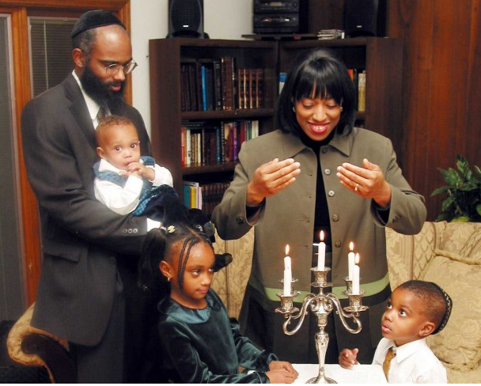
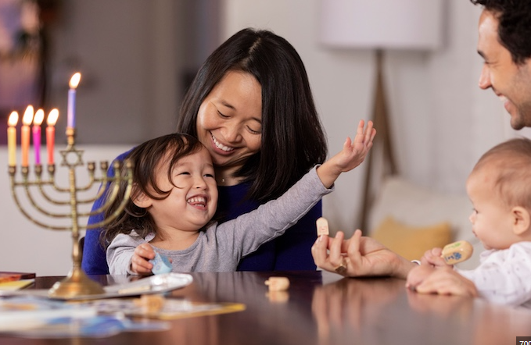
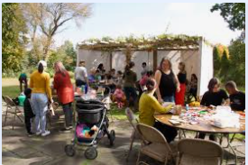
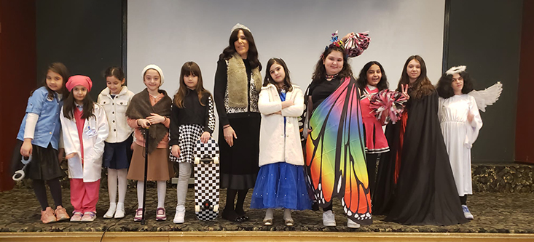

Slide 11
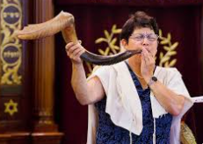
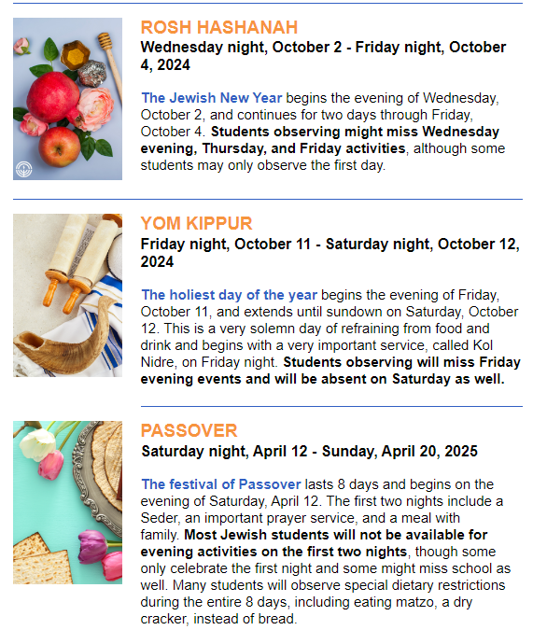
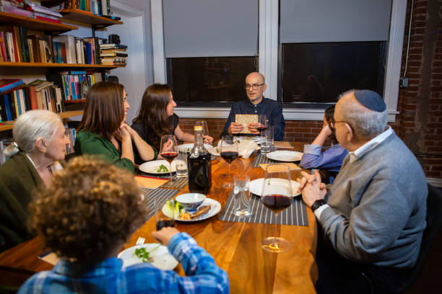

Slide 12
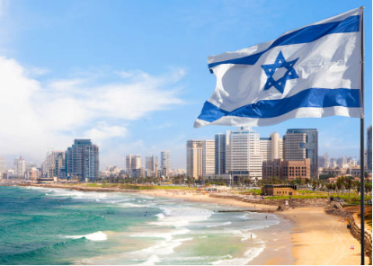
Relationship with Israel
Jews have had a continuous presence in the land of Israel, even during times of exile, for thousands of years
Israel is the Jewish homeland
Jerusalem is the holiest site in the Jewish faith
The first Jewish Temple was built by King Solomon, 10th Century BCE in Jerusalem
Jews pray in the direction of Jerusalem
Israel is central to the Jewish faith and mentioned throughout the Hebrew Bible
Visiting Israel is part of a Jewish spiritual mission
Many Jews know someone in Israel
Jews have a deep connection to Israel
Israel is part of the Jewish identity

Slide 13
Zionism
Zion refers to the Biblical Land of Israel
Zionism refers to support for the existence of Israel
95% of Jews are “Zionist” therefore, usage of the term “Zionist” is a dog whistle for Jews and universities such as NYU have said so.
Zionists is used in current climate as a pejorative, placing Jews underserving of allyship and protection
Has become acceptable to demonize and harass Jews because of their perceived (and real) connection to Israel.
Zionism is the belief that the Jewish people have a right to and need for national self-determination in some portion of our ancestral homeland, and the vast majority of Jews consider this a part of their Jewish identity

Slide 14
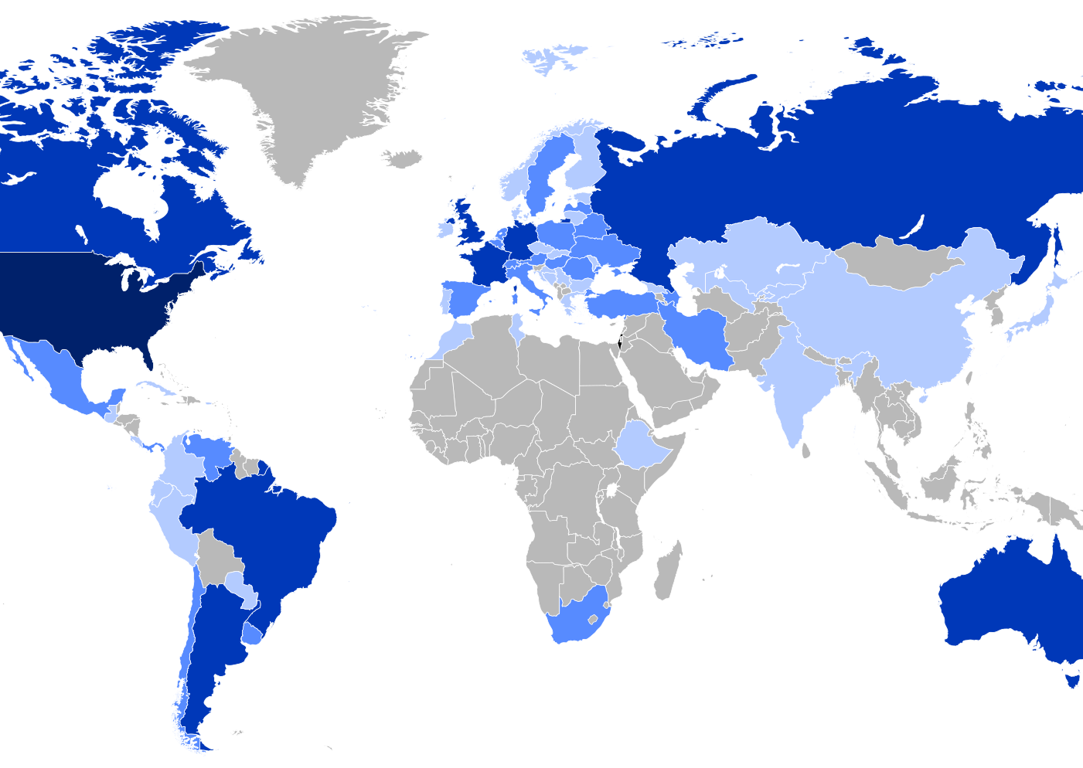
Who is a Jew?
All are welcome to come and visit, learn with us
We don’t proselytize, but anyone who wants to learn about Judaism and eventually become a Jew is welcome through a conversion process and be an equal member
We are not all white, most Jews in Israel are not white, we are middle eastern, North African, Hispanic, Black, Asian, multi-racial, multi-ethnic
Jewish people originate from Israel, but were expelled and turned into a diasporic people
We are only .2% of the world’s population
We live in countries all over the world, but predominantly in Israel and the U.S. (darkest blue to lighter blue)-multiple nationalities
Complex Identity: We are a people, a culture, and religion

Slide 15
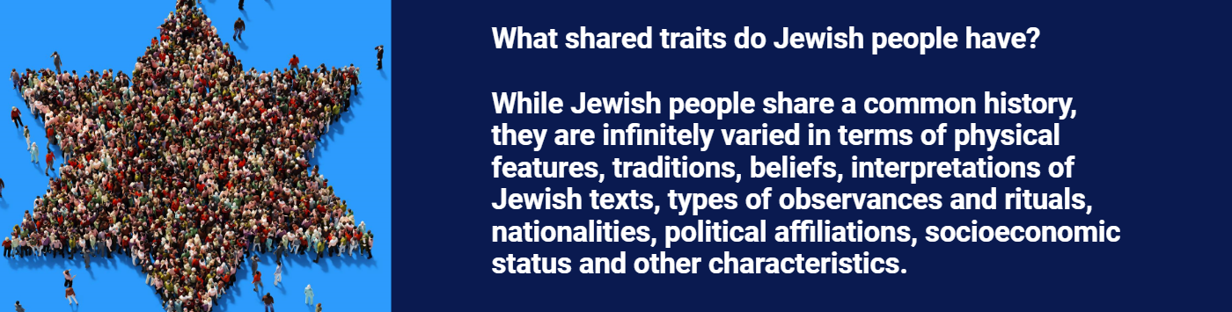
Source: ADL https://adl.org/sites/default/files/education/mini-lesson/antisemitism/story.html

Slide 16
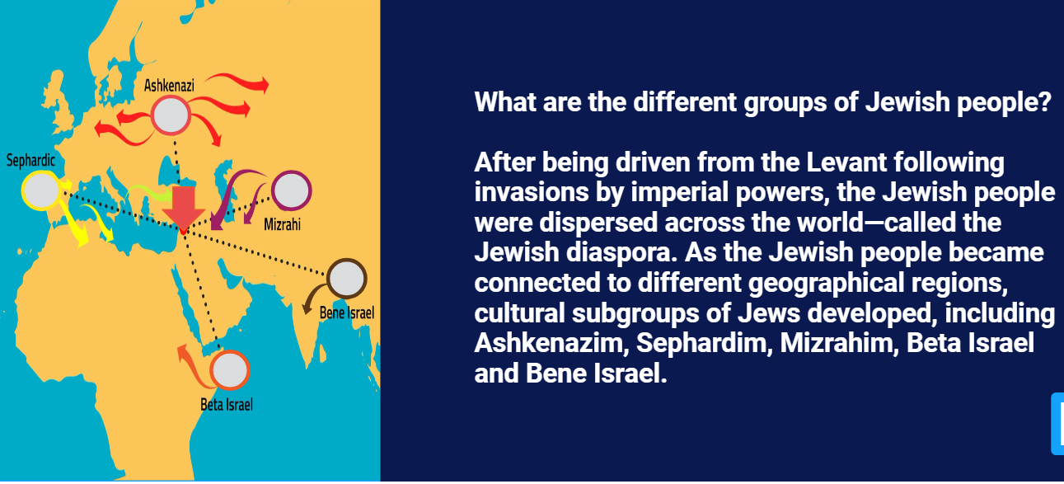
Source: ADL https://adl.org/sites/default/files/education/mini-lesson/antisemitism/story.html

Slide 17
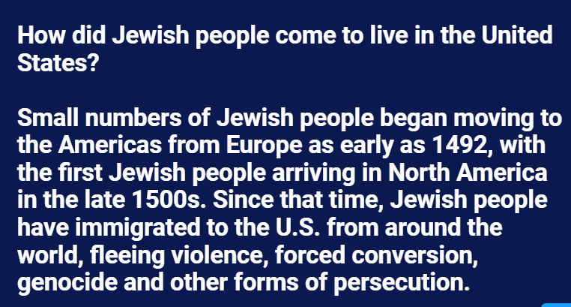
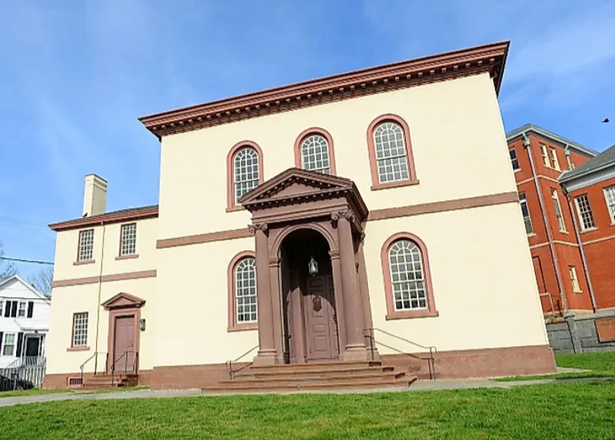
Built in 1763, Touro Synagogue in Rhode Island founded by Sephardi Jews from Spain and Portugal
Source: ADL https://adl.org/sites/default/files/education/mini-lesson/antisemitism/story.html

Slide 18
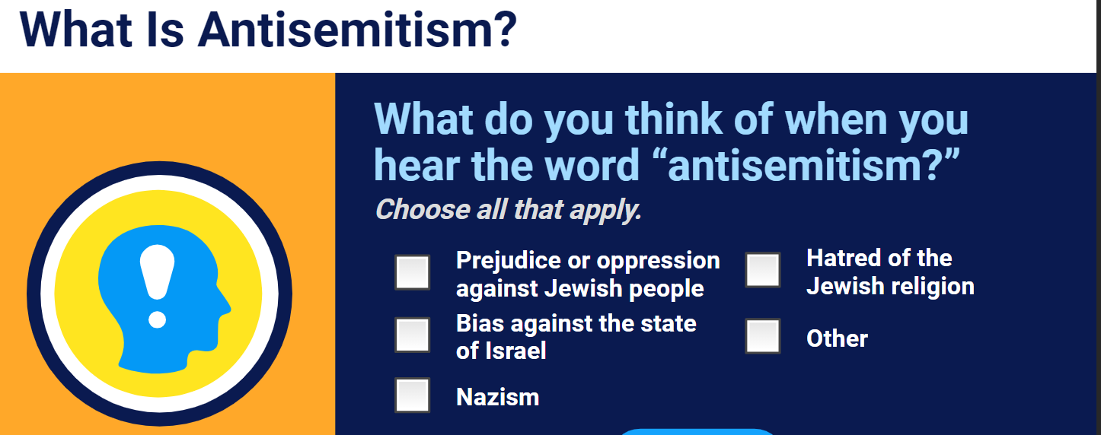
Source: ADL https://adl.org/sites/default/files/education/mini-lesson/antisemitism/story.html

Slide 19
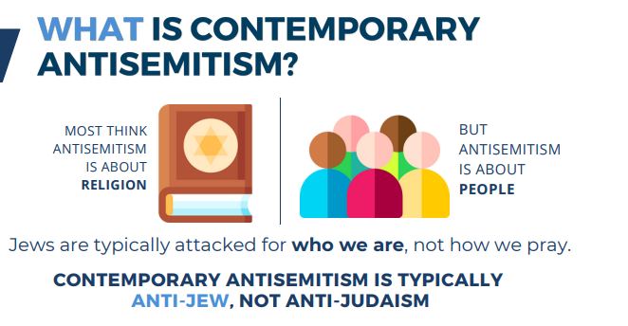
Antisemitism
Hatred of Jews, anti-Jewish ideas, bigotry, bias
Dehumanizes, isolates Jews
Undermines Jewish inclusion and safety
Fuels white supremacy, undermines democracy
Marginalization of Jews
Oppression of Jews
Based on stereotypes and myths about Jewish people and Israel
IHRA definition
Source: Project Shema
Notes:
Adopt the following non-legally binding working definition of antisemitism:
“Antisemitism is a certain perception of Jews, which may be expressed as hatred toward Jews. Rhetorical and physical manifestations of antisemitism are directed toward Jewish or non-Jewish individuals and/or their property, toward Jewish community institutions and religious facilities.”
Criminal acts are antisemitic when the targets of attacks, whether they are people or property – such as buildings, schools, places of worship and cemeteries – are selected because they are, or are perceived to be, Jewish or linked to Jews.

Slide 20
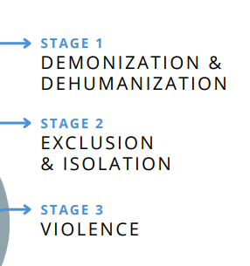

Slide 21
Tropes
Antisemitic stereotypes that repeat throughout history
Power-tiny group of people quests world domination, controls banks, media, government, weather
Greed-Jews stereotyped as stingy, and controlling great wealth
Holocaust denial-dismisses the Holocaust; exploits Jewish trauma
Blood libel-myth that Jews murder children
Christ killers-the myth that Jews murdered Christ (the Romans did)
Disloyal-Jews are not “one of us”
Anti-Zionism-rejects Jewish nationhood and right to self-determination in their ancestral land
Demonizing Jews because of protesting Israel’s government
Notes:
Blocking Jews or Zionists from entry to campus or use of walkways: Ucla, Columbia, protesting Jews at a shabbat dinner: Columbia; vandalizing and graffiti on Hillel—UT Austin—this is attacking Jews, not Israel

Slide 22
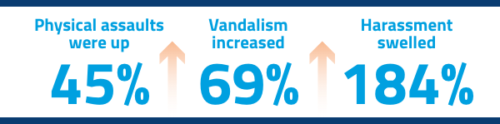
Antisemitism on the rise
8,873 antisemitic incidents were recorded by ADL last year.* That averages out to one antisemitic act every hour of every day throughout the entire year.
Notes:
Among the thousands of incidents that are part of this dangerous surge of antisemitic acts:
A man shot and wounded a Jewish congregant leaving his synagogue.
A group of 20 attackers assaulted three Jewish teenagers in public.
An intruder armed with a knife broke into a Jewish family’s home and said, “I’m going to kill you because you are Jewish,” then attacked one of them.
Someone even shot at Jewish high school students at school.

Slide 23
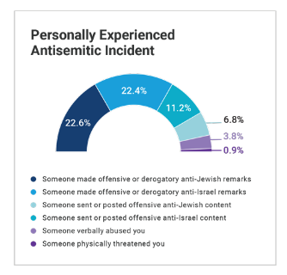
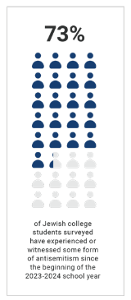
Source: ADL https://www.adl.org/resources/report/campus-antisemitism-study-campus-climate-and-after-hamas-terrorist-attacks

Slide 24
JEWS ARE THE MOST TARGETED RELIGIOUS GROUP
Just 2% of the U.S. population, Jews are the targets of more than 60% of religiously motivated hate crimes according to FBI data.

Slide 25
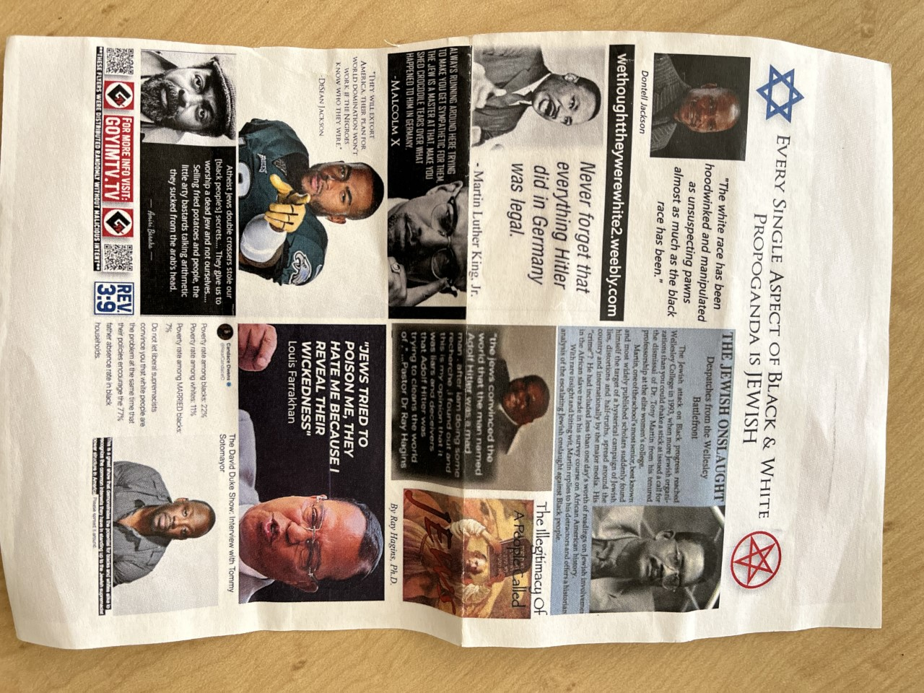
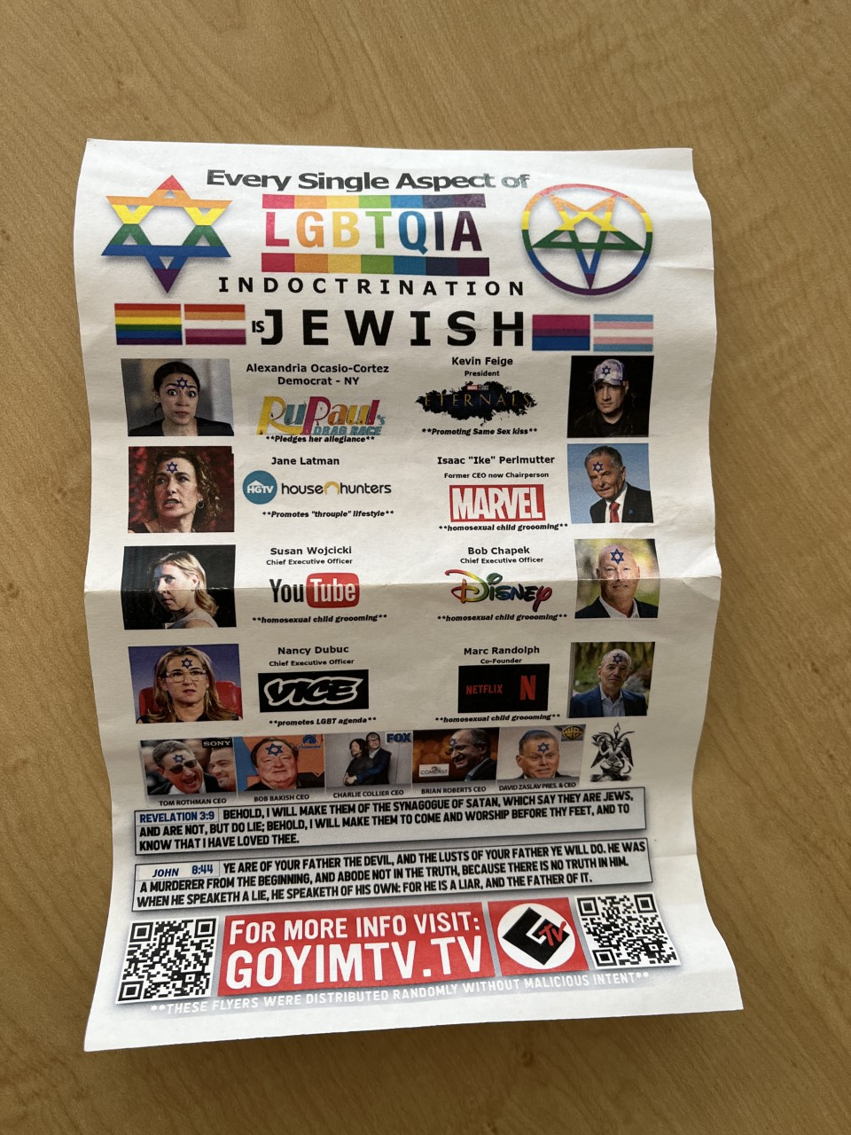
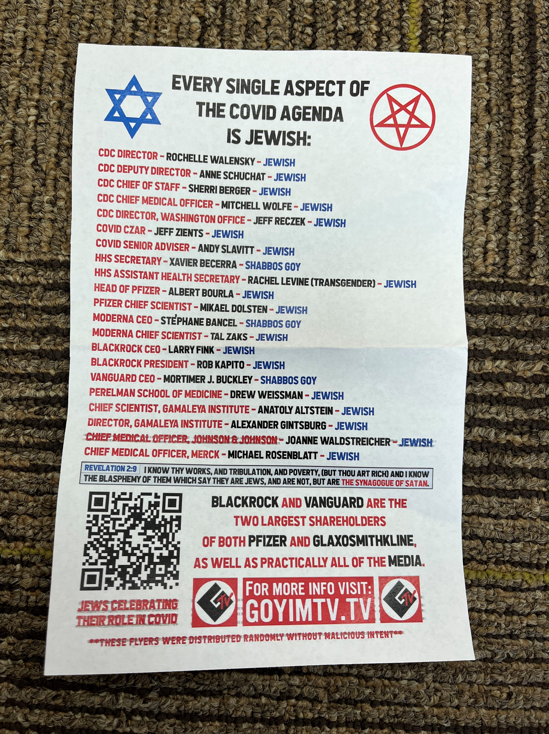
Conspiracy Theories
Jews as greedy, evil, all-powerful, untrustworthy, and/corrupt
Jews/Zionists control the media and that’s why you cannot trust the western media; Jews/Zionists are using their power to control major government policy.
Blaming Jews for killing Jesus
Q-Anon-Jewish baby killers
Blood libel
Replacement theory

Slide 26
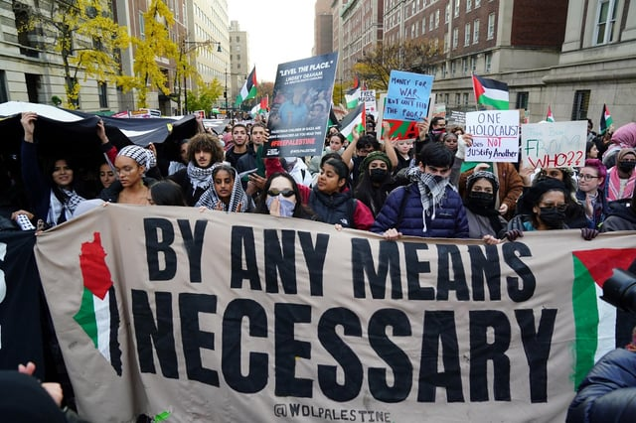
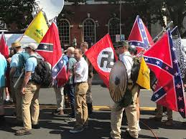
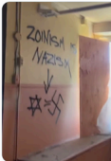
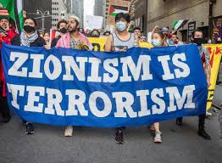
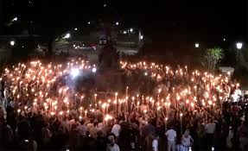
Far Left
Demonizes Jews as exemplary of white supremacy , colonist
Far Right
White supremacists demonize Jews as non-white and threatening to whites (replacement theory)
Notes:
There was a banner over 410 this summer that said no Zionists in government
Who did you think put that up? Which side?
It was Patrot Front

Slide 27
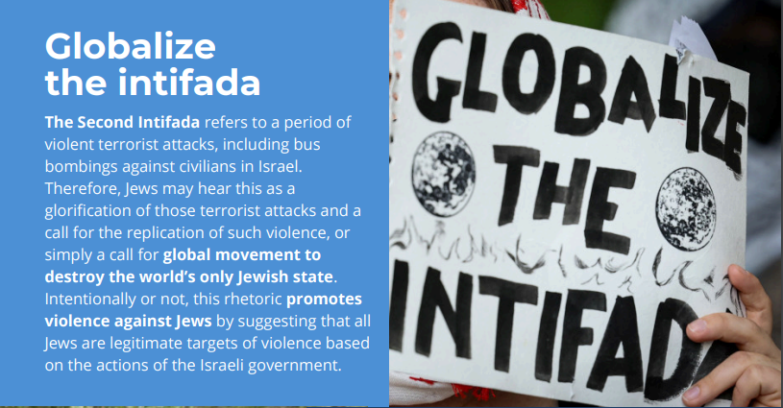

Slide 28
What can you do?
Educate, be an ally
Publicly affirm that we cannot normalize attacking Jews
In person-Disrupt
  Speak out
  Call it out
  Advocate
  Report

Slide 29
Questions?
Lisa Epstein, PhD
Director of the Jewish Community Relations Council
210-302-6962
epsteinL@jfsatx.org

Slide 30










Schools Under Investigation for VI Violations

Slide 31



Title VI 1964 Civil Rights Act: Non-Discrimination in Federally Funded Programs
(HOP 9.01)
“No person in the United States shall, on the ground of race, color, or national origin, be excluded from participation in, be denied the benefits of, or be subjected to discrimination under any program or activity receiving federal financial assistance.”
ENFORCEMENT:
The U.S. Department of Education’s (ED) Office for Civil Rights (OCR), with 12 regional offices and a headquarters office in Washington, D.C., enforces Title VI as it applies to programs or activities that receive financial assistance from ED.
JULY 2024

Slide 32
It is important to report all known information to EOS. If it is an immediate health and safety risk, UTSA PD, then BIT, too.
ED is asking in some resolution agreements:
Full documentation for how investigations are handled looking at the totality of circumstance
Annually training on non-discrimination and training for those involved in investigations.
Thorough investigations of cases that are reported.
Reviews of policies and the language included and make updates if needed.
TO REPORT GO TO www.utsa.edu/eos/report-an-incident/
JULY 2024

